Slide 1
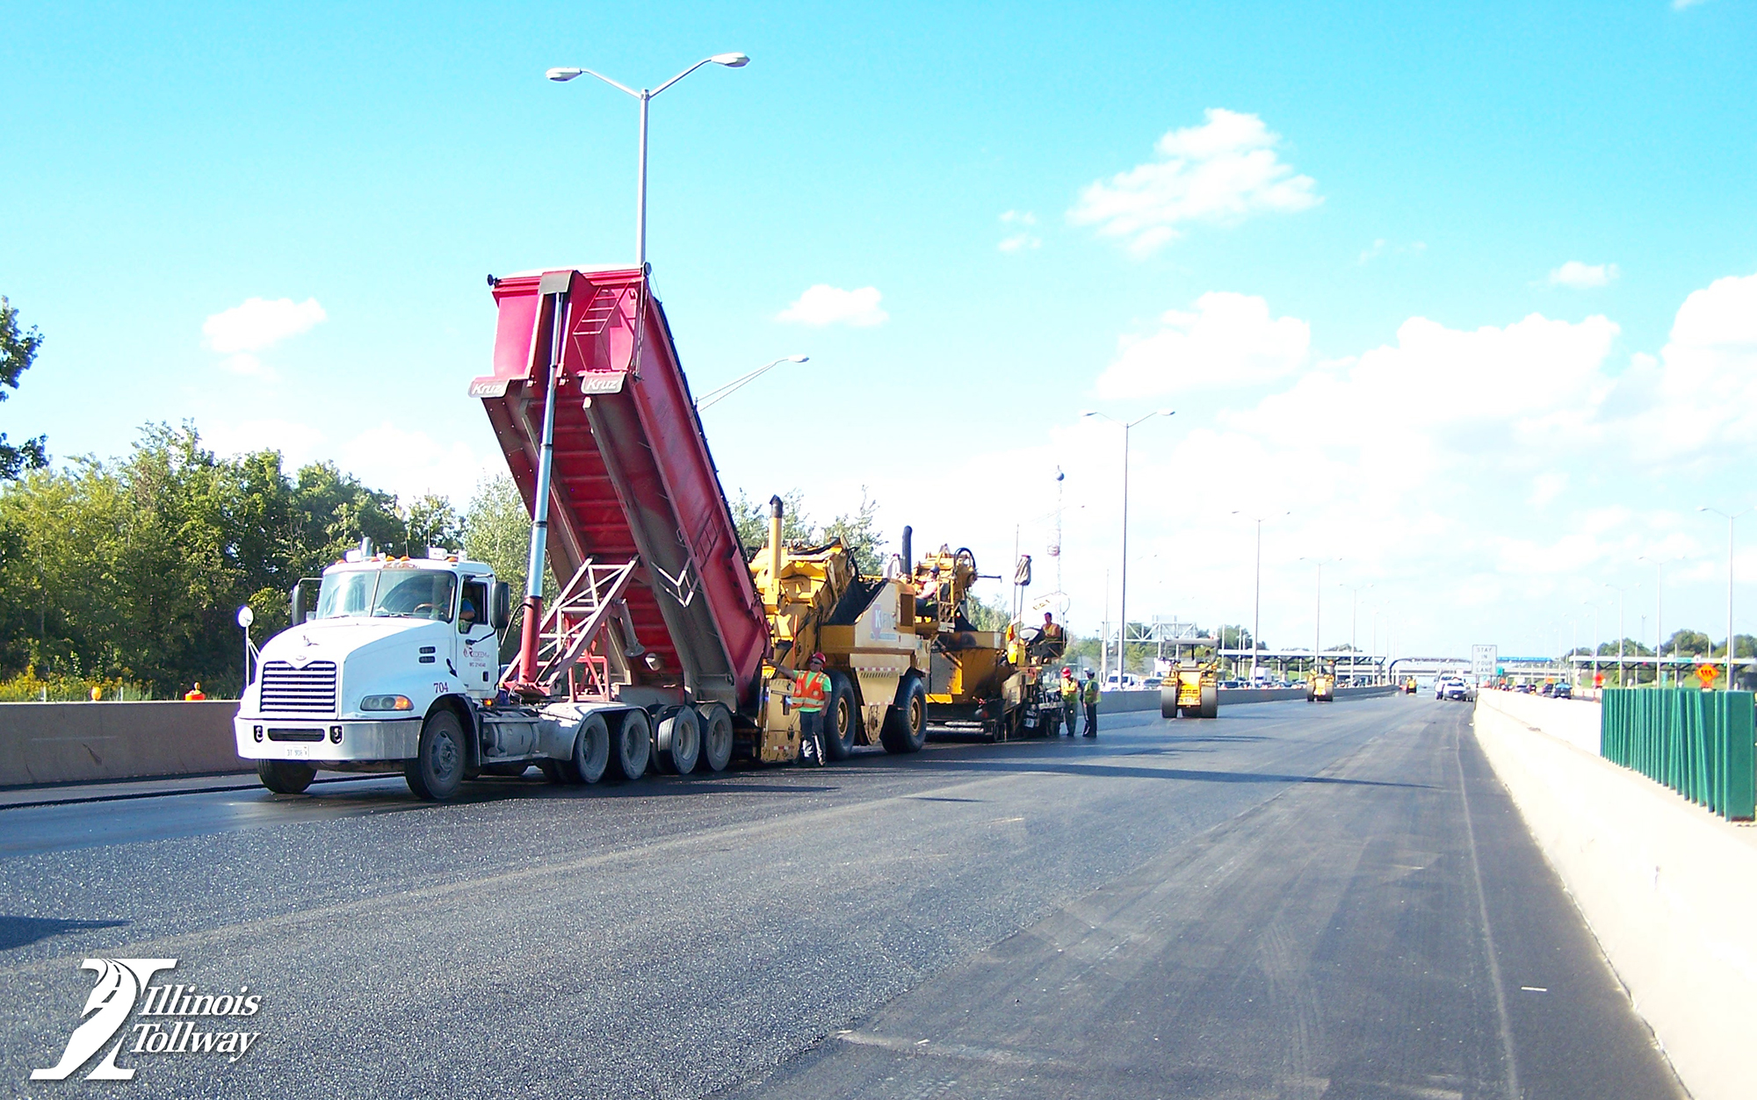
How Being Green Saves Green ($) Illinois Tollway Savings Through Sustainability
2019 TRC Transportation Conference & Equipment Expo
August 16, 2019
Bill Vavrik
Illinois Tollway
Infrastructure Management Consultant

Slide 2
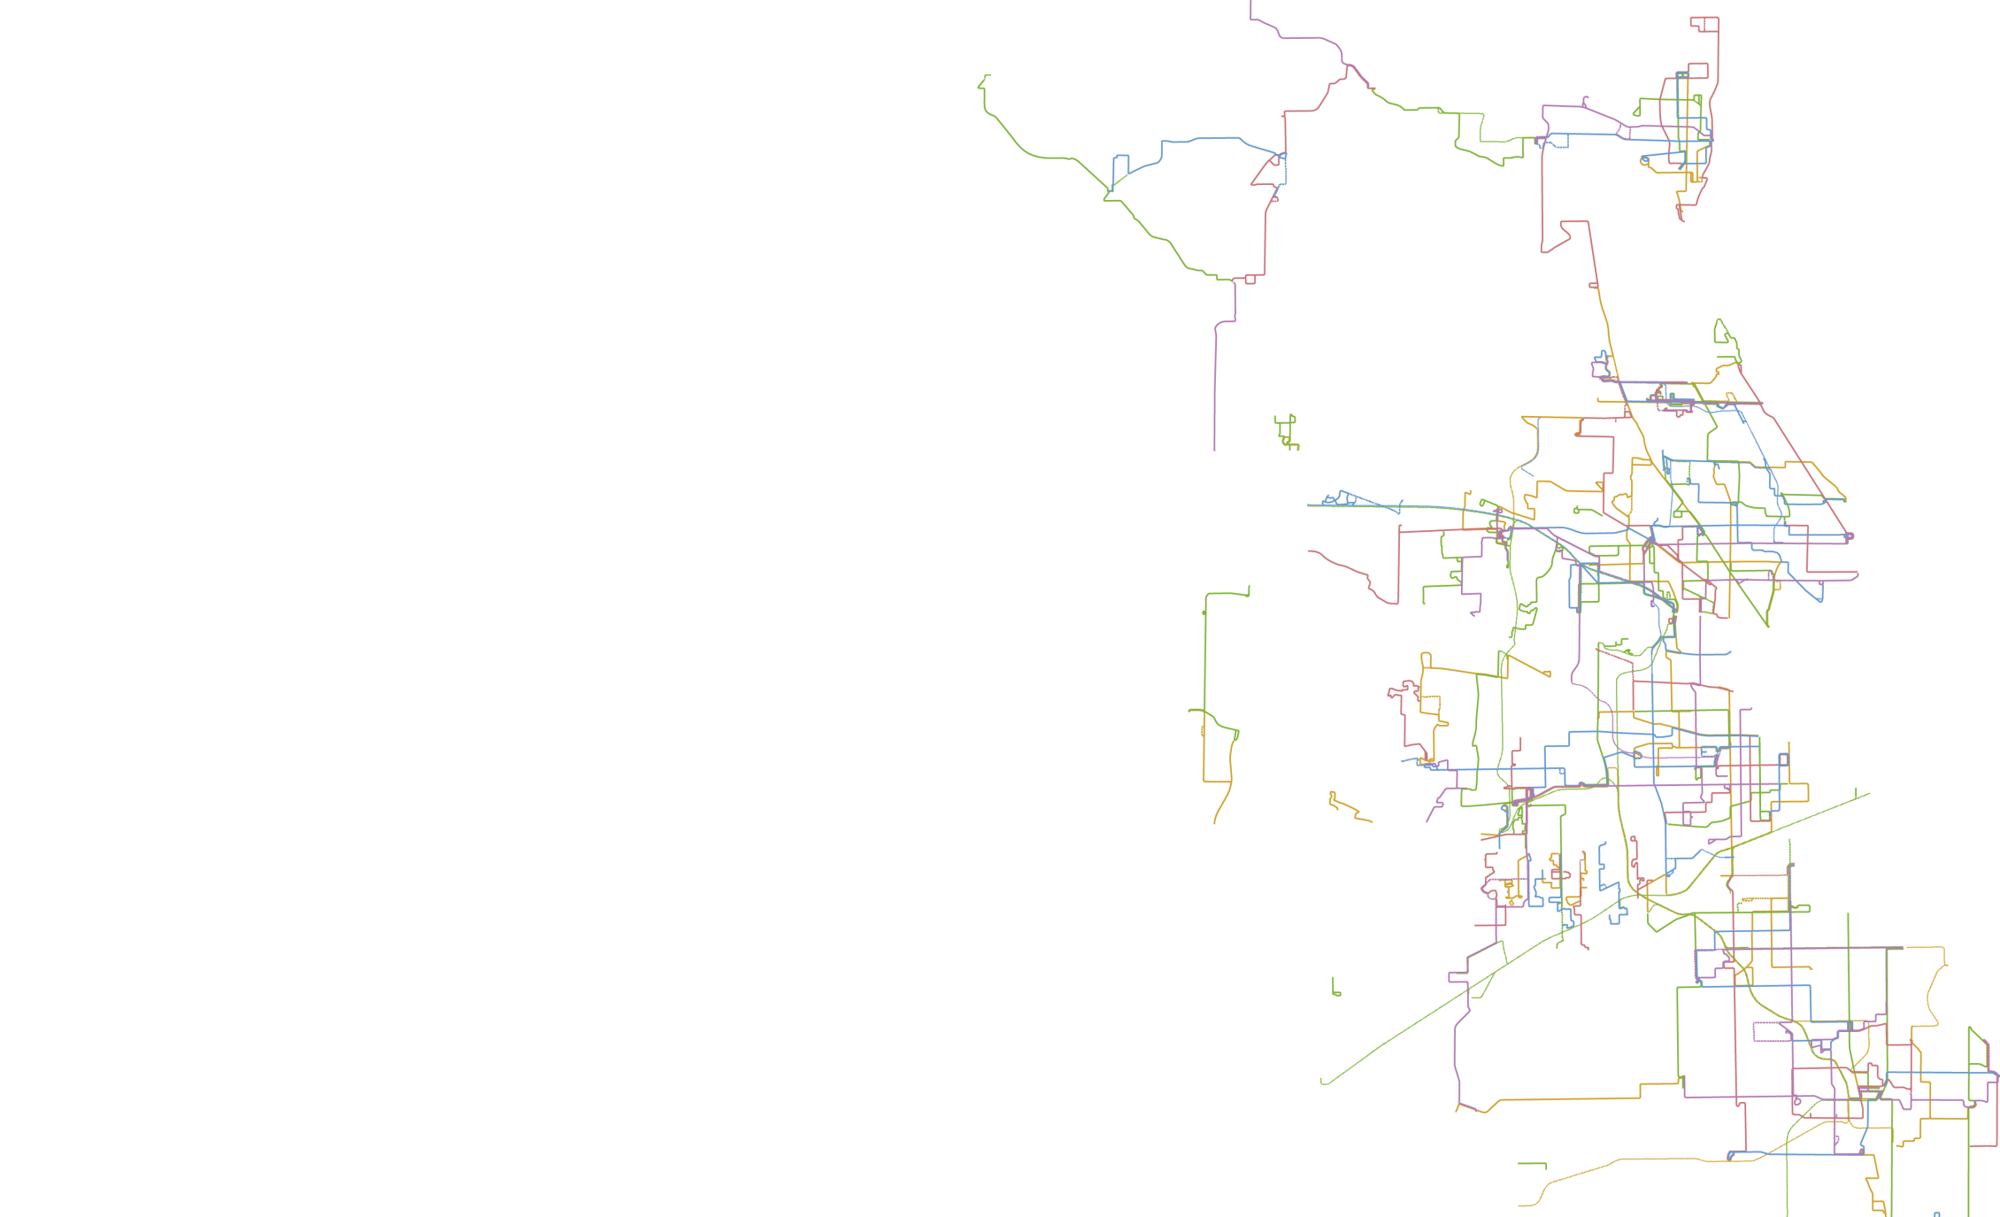
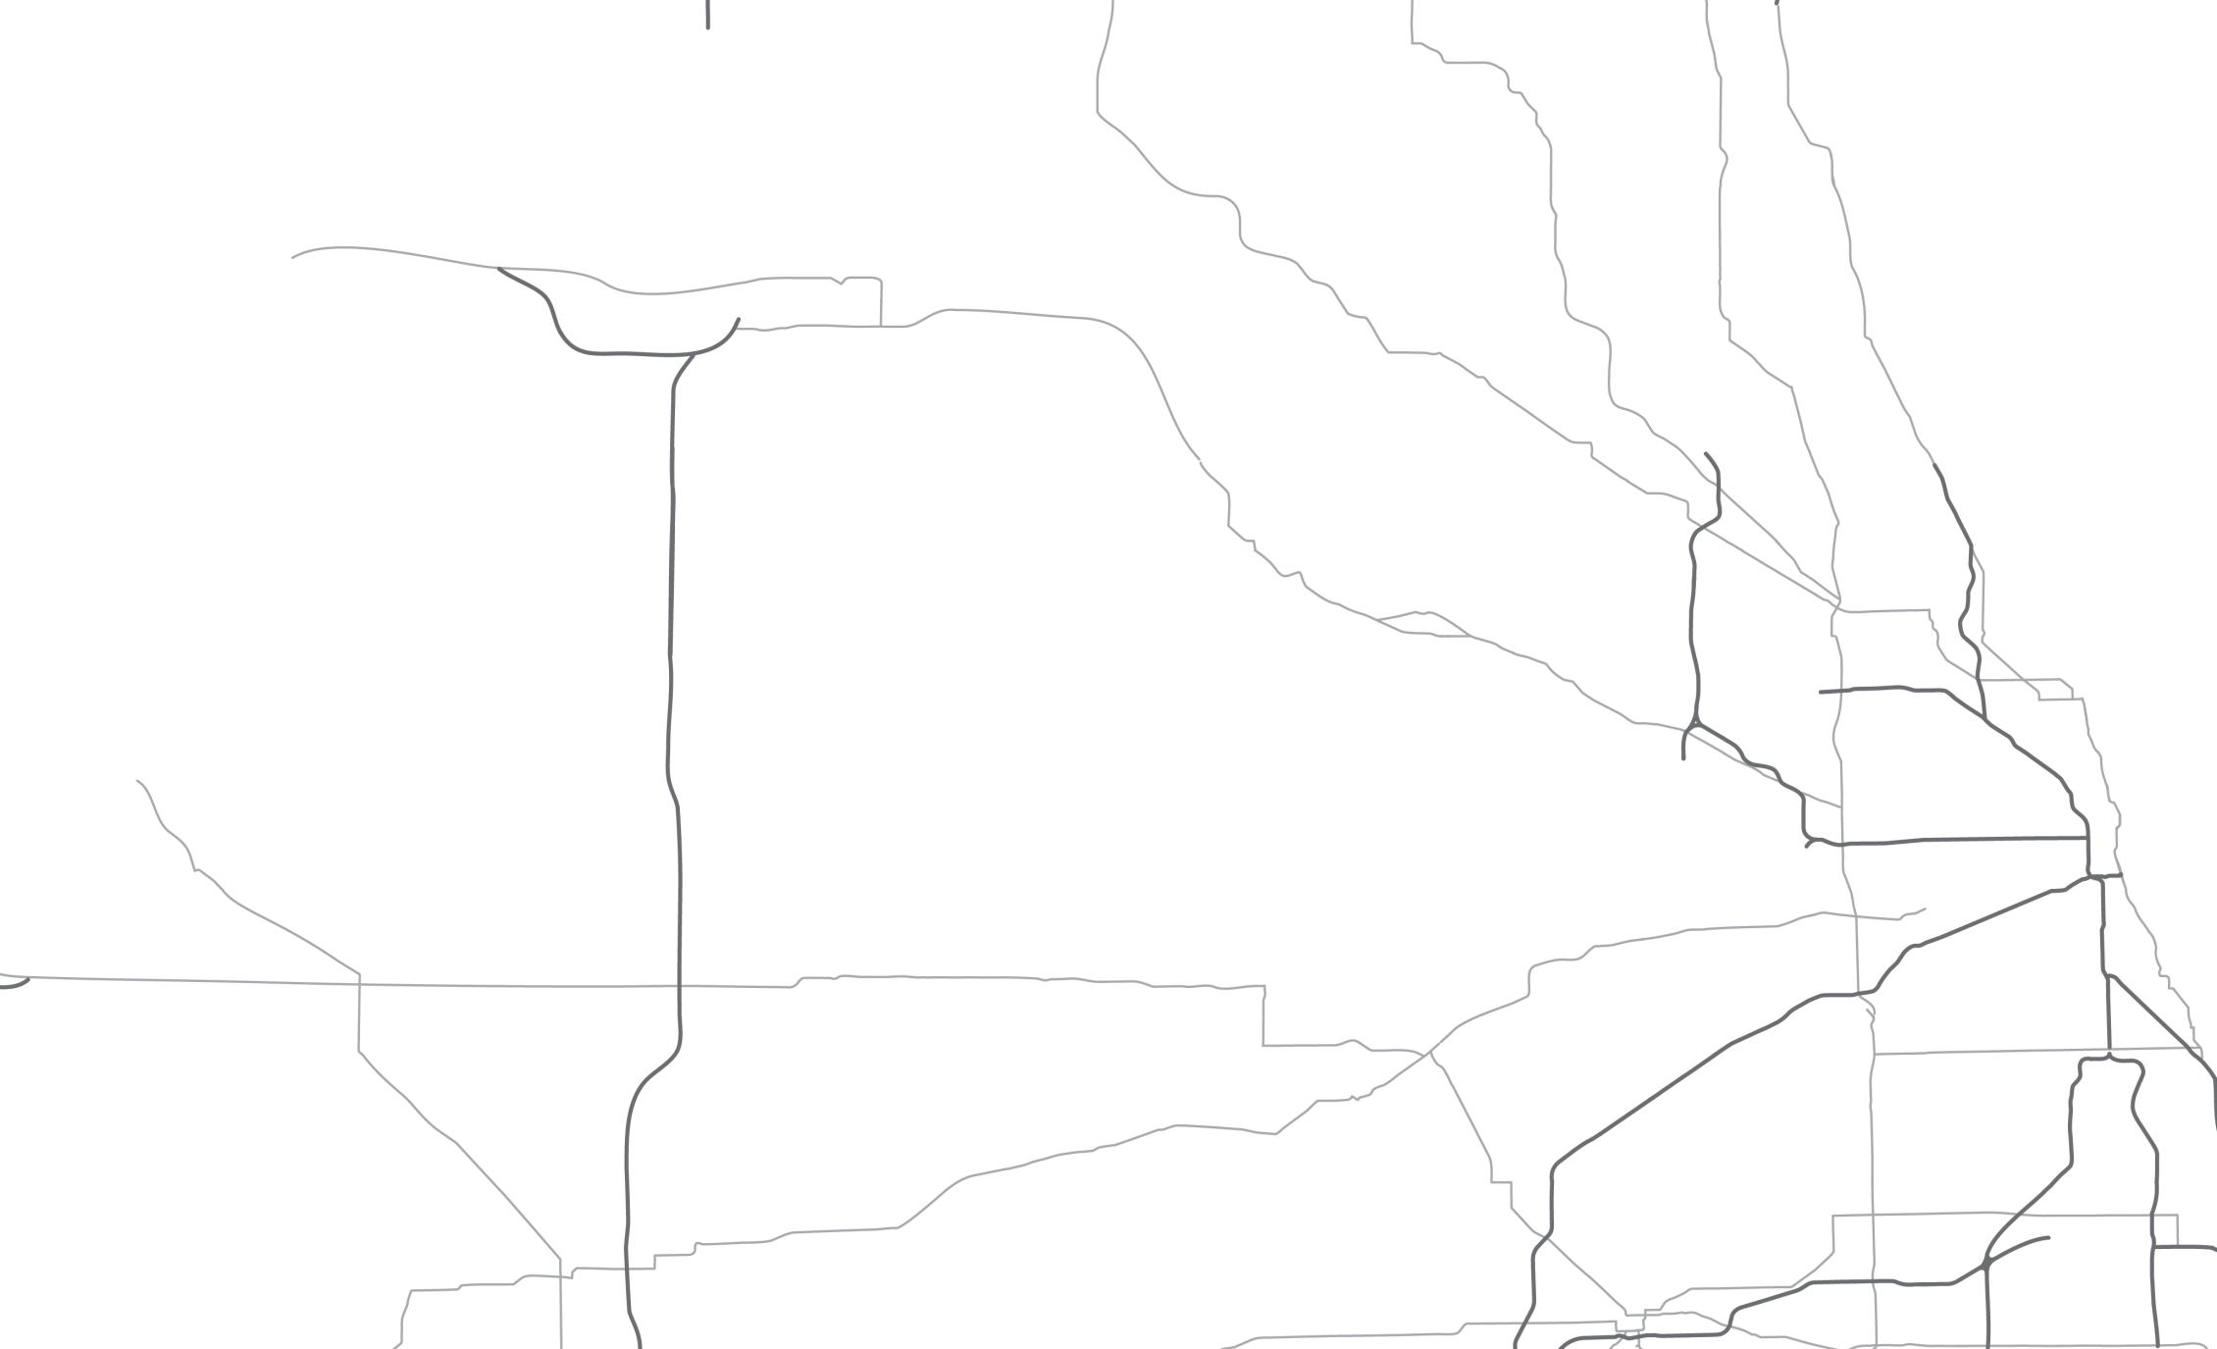
About the Tollway
Agency created in 1953
Separate from IDOT
User-fee system
Opened in 1958
Five roadways spanning 294 miles across 12 counties
Tri-State Tollway (I-94/I-294/I-80)
Jane Addams Memorial Tollway (I-90)
Reagan Memorial Tollway (I-88)
Veterans Memorial Tollway (I-355)
Illinois Route 390 Tollway
Serves more than 1.6 million vehicles a day
Notes:
The Illinois Tollway was created by the Illinois Legislature in 1953.
The Tollway is responsible for the construction, operation, regulation and maintenance of tollroads throughout Northern Illinois.
The Tollway is not privately owned. It is a state agency and completely separate from the Illinois Department of Transportation.
The Tollway does not receive state or federal tax dollars to support maintenance and operation. It operates a user-fee system, which means that only those who use it pay for it.
The original Tollway system opened in 1958, serving as a bypass around Chicago to connect Indiana and Wisconsin. Today, most of our customers are daily commuters traveling from one suburb to the next.
The Tollway system consists of five roadways that span 294 miles across 12 counties in Northern Illinois:
Tri-State Tollway (I-94/I-294/I-80)
Jane Addams Memorial Tollway (I-90)
Reagan Memorial Tollway (I-88)
Veterans Memorial Tollway (I-355)
Illinois Route 390 Tollway
The Tollway system serves more than 1.6 million vehicles a day.

Slide 3
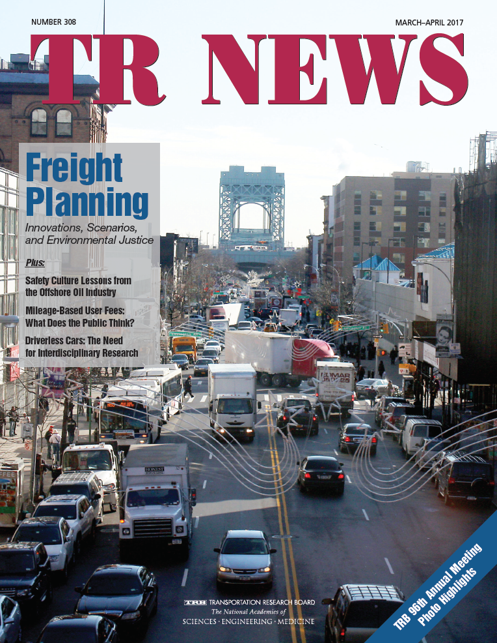

Slide 4
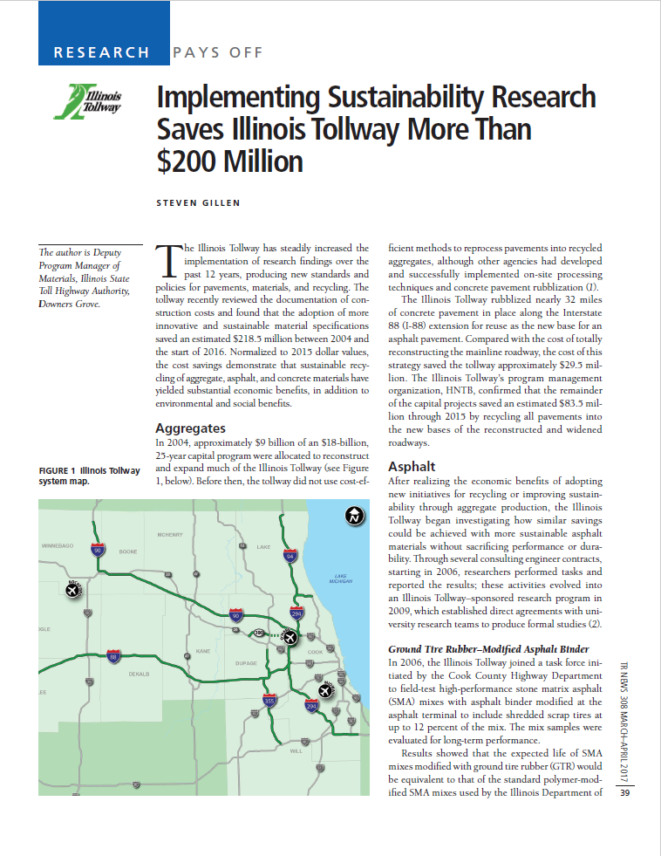
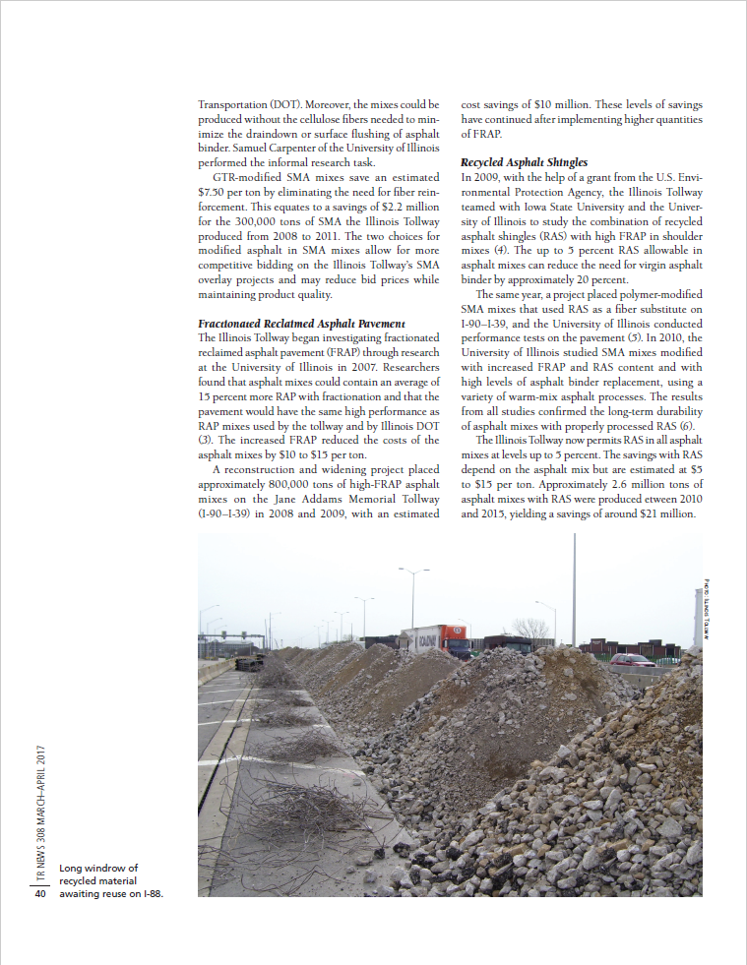
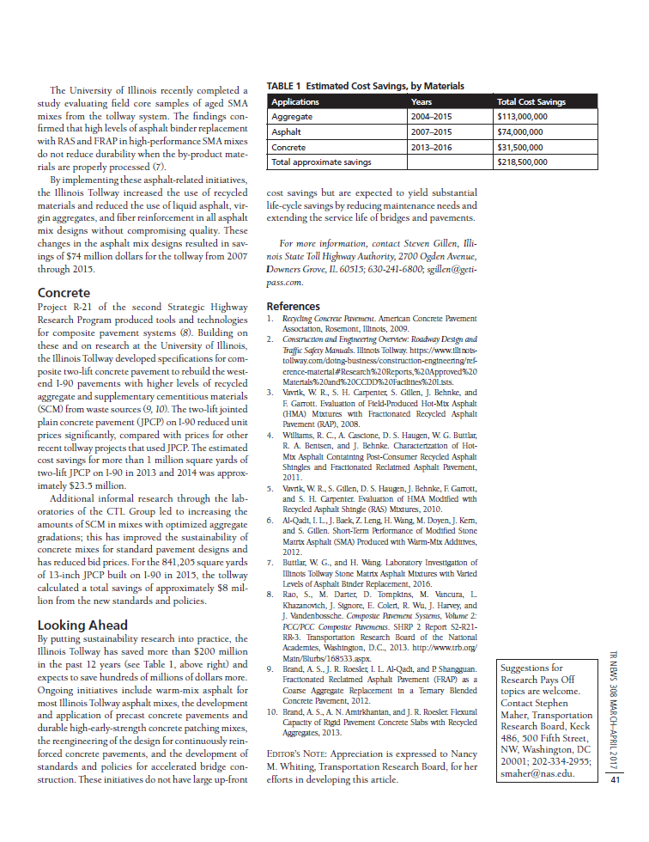

Slide 6
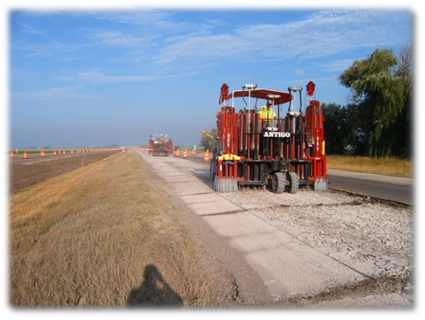
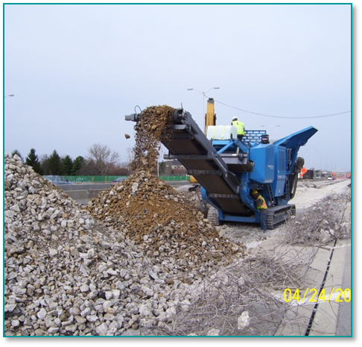
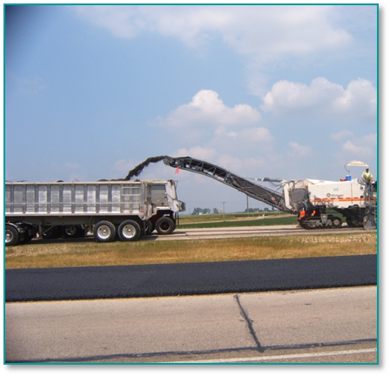
Aggregate Initiatives in Recycling
Cost savings started from the bottom up using established methods of recycling
Existing aggregate subbases re-used
Existing concrete recycled by rubblization
Existing concrete recycled as new porous base
Existing asphalt recycled for many applications
Notes:
Recycling relative to the pavement base construction evolved when the first capital program was initiated nearly 15 years ago, the extensive cost savings that resulted from such recycling was realized. How such similar initiatives could be applied to the pavements and structures being built was the big unknown.
In order to solve these problems, the Tollway initiated numerous research projects with various universities to determine how recycled or waste product materials from both the Tollway pavements being excavated and from outside sources could best be recycled into our new pavements without impacting the quality or life of the pavements.
The research projects were first informal lab investigations funded through consulting contracts. As these initial informal projects showed continued success, a formal research program evolved about 10 years ago in which agreements for studies were directly developed between a university and the Tollway. Today, all research problem statements are solicited to multiple universities for the best studies to be proposed to resolve problems or issues.
Here are the aggregate initiatives that the Tollway has standardized for all reconstructed pavements and allow on all newly constructed pavements.
Summarizing the research and cost calculations in detail would take additional hours. Detail of this all can be found in a 30-page report that I can easily provide to anyone upon request, in a shorter paper in the TRB directory for meeting and an even shorter summary published in TRNews magazine.

Slide 7
Research Opened the Door for the Tollway to Reach Sustainability Goals
Pavement initiatives started with asphalt
Ground tire rubber mixes tested and analyzed
Hot and warm asphalt mixes with varied levels of FRAP produced and tested for performance
Roof shingle and high FRAP mixes studied
Early age rutting potential of high ABR SMA mixes with various warm-mix processes studied
In-place SMA surface mixes with low, medium and high ABR content studied to show performance being maintained
Notes:
The Tollway’s research started with asphalt mixes back in 2006 when a local terminal first offered to produce terminally blended GTR modified liquid asphalt. The agency teamed with a number of other local agencies and performed trial placement and production using the many short life temporary pavements that were being used for new concrete construction as our test beds.
Samples were sent off to the University of Illinois labs through informal agreements to study the performance of mixes produced using such a modifier. The results were positive and terminally blended GTR modifiers are a standard option to SBS polymer modifiers today.
The development of FRAP specifications to fit the needs of our mainline and shoulder grindings was the next big initiative to establish specifications for. Numerous studies evolved and resulted in specifications that allowed for much higher levels of RAP in mixes as a result of the fractionation process.
Then RAS came into the picture and a detailed formal study through Iowa State and the University of Illinois was initiated in 2009 that helped us to develop specifications for both RAS processing and effective limits for use in all Tollway asphalt mixes.
And, finally, how the warm-mix processes would impact such mixes having much higher ABR levels as a result of FRAP and RAS resulted in the need for more studies. Today warm-mix asphalt with high ABR levels are mandated on all Tollway projects.
A recently completed study of aged in place high performance SMA mixes with varied levels of ABR and both SBS and GTR modifiers and both with and without a warm mix process used showed little difference in performance of these mixes. Cracking potential in particular has not been impacted. Numerous cores of mixes placed over the last 9 years were evaluated.

Slide 8
Asphalt Research Continues
Other options for ground tire rubber modifications being explored
Research to find the best lab test methods to use with performance-based specifications for asphalt mix designs
Notes:
The first one is to study the performance of other ground rubber processes, one being the dry process of feeding grounded tires into the plant directly and another using GTR pellets that can be more easily blended at the asphalt terminal or refinery.
The right photo shows the dry process in progress at one of our plants last summer in which trial batches were produced and test sections placed.
Another large scale study looked at the best way to develop an asphalt mix design process that uses performance measurements for design rather than volumetric properties.
This is for mix designs only, not for construction as the asphalt industry has a ways to go to find a simple cheap and fast test method for field measurement of asphalt crack resistance.
However, for most of the Tollway’s research to date, the DCT tester and Hamburg wheel have been effective means of measuring crack and rutting resistance.
The Tollway needs to study the best ways to specify measurement of performance and establish the limits for measurement. The left photo shows a DCT test specimen.

Slide 9
Summary of Asphalt Mix Savings
Fractionated Reclaimed Asphalt Pavement (FRAP)
FRAP since 2007 – Split into multiple sizes
Increased use of FRAP saving up to $15/ton
Reduces need for virgin aggregate and liquid asphalt
Ground Tire Rubber
GTR started in 2006 research sections
Used primarily in SMA mixes – eliminates need for fibers (draindown)
Competes with SBS modifiers to reduce pricing
Since 2008, over 197,000 tires have been recycled
Use of RAS allowed for asphalt binder replacement (ABR) levels to go higher and reduced need for fibers in SMA

Slide 10
More Asphalt Initiatives
Recycled Asphalt Shingles (RAS)
Research in 2009
Allow up to 5%
Replaces fibers, high asphalt binder replacement
Improves material properties
Warm Mix Asphalt
Now standard material – hot by permission only
Environmental savings
Total savings since these initiatives were introduced in 2006 has saved the Tollway approximately $106M

Slide 11
Concrete also included…
NCHRP study on quietest pavement textures
Development of specs for performance-engineered concrete mixes for patching, HPC decks and new pavements, most all designs fully optimized and ternary
SHRP2 R05 project on precast pavements
SHRP2 R21 project on composite pavements
University of Illinois evaluation of black rock concrete mixes for composite pavements
Performance-related specifications for concrete pavement construction developed and implemented
Notes:
This slide shows a listing of how the Tollway further explored many other more sustainable initiatives relative to concrete and concrete pavements, once again all supported by research studies. Many of these initiatives resulted in obvious social and environmental benefits, not just economic benefits.
These studies include:
An NCHRP study on the quietest pavement textures for concrete pavements. As many as 16 surface finishes were evaluated that resulted in our tining specifications to be changed from transverse to longitudinal.
The specifications for concrete mix designs were converted from prescriptive-type specifications to performance-based specifications through studies at the CTL Group laboratories. This has led to most of Tollway mixes to now be optimized in gradation with less Portland cement needed and higher levels of supplementary cements used.
The involvement in an FHWA SHRP2 R05 project on precast pavements helped the Tollway develop its own generic precast pavement system. Thousands of precast pavement slabs have since been placed on our system with great social benefit of minimizing traffic impact as we rehabilitate existing roadways.
Involvement in the SHRP2 R21 project on composite two-lift concrete pavements combined with research on black rock or coarse RAP containing concrete mixes at the University of Illinois cleared the path for nearly 35 miles of reconstructed and widened I-90 to be built as two-lift composite pavement for both great environmental and cost benefits.

Slide 12
Design Practices Contribute
Jointed concrete built on asphalt base with asphalt shoulders
Pavement ME to optimize designs for actual conditions and expected future traffic

Slide 13
Savings through 2018
Savings indirectly related to research by others
Aggregate-related initiatives - $134,000,000
Pavement design initiatives - $40,500,000
Savings directly related to recent Tollway research
Asphalt-related initiatives - $106,000,000
Concrete-related initiatives - $38.9,500,000
Total estimated savings = $301,000,000

Slide 14
Goal is to be Sustainable
Economic
Life Cycle
Cost Analysis
Environmental
Social
Sustainable
Life Cycle
Assessment
Sustainability
Rating System
Sustainable
Notes:
Sustainability can’t be improved if it is not measured to determine if improvements are occurring. The use of life cycle cost analysis for various pavement types is applied to all new pavement reconstruction and new construction projects.
Sustainability is a weighted factor in all LCCA calculations and the savings that improved sustainability has provided gives good reason to integrate it into LCCA programs. [Give detail of more than $100 million savings over 8 years.]
THESE NOTES ARE OLD
The next step will be the implementation of a sustainability rating system most applicable to the Tollway system. CH2M Hill and AECOM are the Tollway’s consultants leading the effort to get the FHWA’s INVEST rating system implemented fully for the Tollway over the course of the next year and a half. This program helps to measure the social benefits impacts that improved or reduced sustainability can have on an agency’s capital program and operations.
The development of life cycle assessment tools is another big endeavor that will be led by our pavement management consultant, Applied Research Associates, in combination with a number of researchers including many from the University of Illinois. LCAs are needed to measure the environmental leg of sustainability and is what I will be putting attention to in this presentation.
Millions of dollars are being provided by the Tollway to complete these goals over the course of the next year. For the amount of investment being put into these projects, a good return on our investments will be critical.

Slide 15
Rating System for Qualitative Measurement
Project Development
System Planning and Processes
Operations and Maintenance
Infrastructure Voluntary Evaluation Sustainability Tool (INVEST)
www.sustainablehighways.org
Notes:
INVEST reviews the whole transportation infrastructure lifecycle, not just one part.
It is built around three modules that represent three phases of the infrastructure’s lifecycle – System Planning & Processes, Project Development (which includes project planning, design and construction) and Operations & Maintenance.
No matter where a transportation agency is in this lifecycle, INVEST can help it assess its sustainability progress and identify areas for improvement.

Slide 16
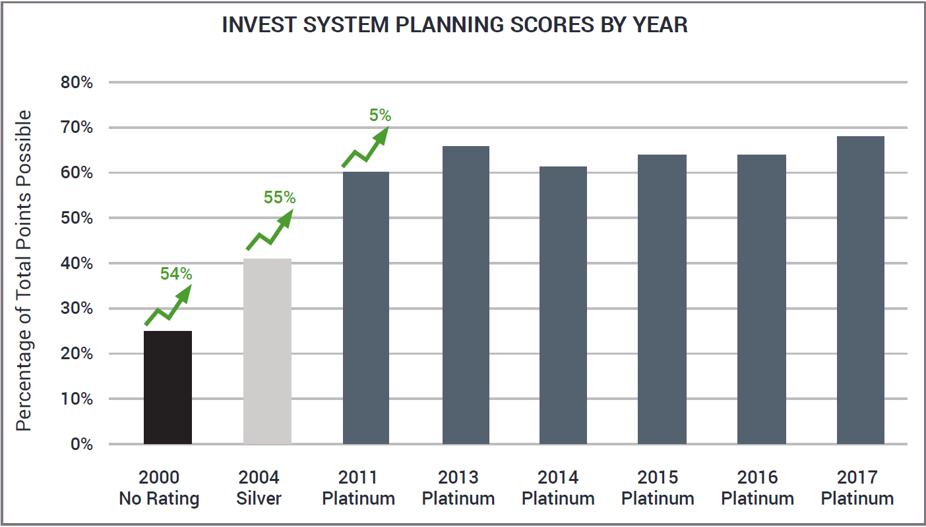
System Planning Scores
Using water quality data from IL Natural History Survey and Geological Survey to minimize impacts during planning
Significant stakeholder outreach on physical access and affordability

Slide 17
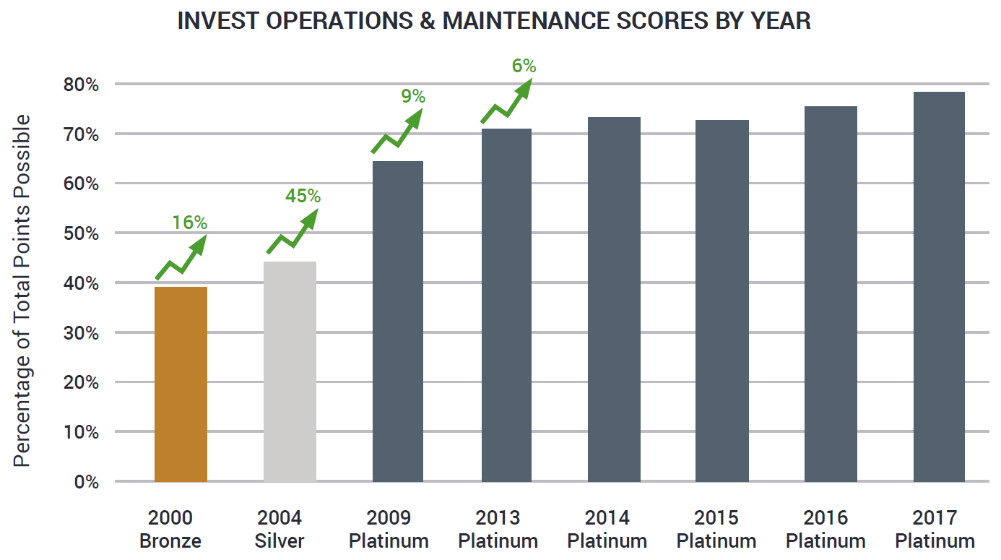
Operations and Maintenance Scores
Chloride reduction program
Routinely using ITS to anticipate and reduce congestion

Slide 18
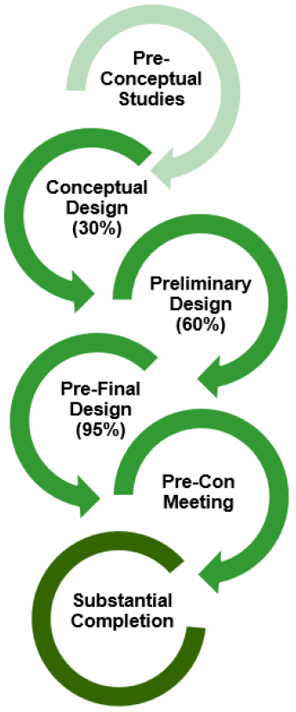
Project Development INVEST Scoring
Used on projects with construction cost over $10M
Projects evaluated at throughout design
Brainstorming in early design
Sustainability workshops
Establish target Invest score at 30% review
Invest score for As-Designed condition
All scorecards part of design deliverables
Final score at substantial completion

Slide 19
INVEST Project Development Results
2013 – 2014 Projects averaged Silver Rating
2015 – 2018 Projects averaged Gold Rating
19 categories increased by 30% or more over baseline
In 2018 Project achieved maximum points in:
Context-Sensitive Project Development
Educational Outreach
Habitat Restoration
Ecological Connectivity
Pedestrian Access
ITS for System Operations
Site Vegetation
Reduced Energy and Emissions in Pavement Materials
Construction Equipment Emission Reduction
Construction Quality Control Plan

Slide 20
LCA is Next Step
Why must we quantify?
If it is not quantified, it is not valued
Without value, it won’t get done
Without value, it cannot be improved upon
Without value, there is no incentive

Slide 21
Tollway LCA is Full Roadway System

Slide 22
Asphalt Material Improvements Continue
2000 Mixes
No recycle content
SBS-modified binder
2008 Mixes (as constructed)
SMA surface and binder for mainline
ABR content ranging from 15 to 47 percent
GTR binder
2014 Mixes
Warm-mix asphalt standard
ABR content ranging from 24 to 53 percent
Include RAS
2019 New Special Provisions
Provide contractor options
WMA standard
GTR allowed terminal or dry
RAS allowed
Mix performance testing

Slide 23
In summary…
Research leads to innovation…
Innovation facilitates doing more with less
Measurement allows good management
Managing facilitates sustainable success

Slide 24
Questions

Slide 25
THANK YOU
Bill Vavrik, Ph.D., P.E.
ARA
V.P. Transportation, ARA
Office: 217.356.4500
wvavrik@ara.com

